Slide 1
Sprint Review: SVOT & Renewals
Sprint 4
28 Apr – 23 May

Slide 2





Sprint Overview
Sprint Numbers
Sprint Links
Key Dates
Weeks
4
Sprint 4 SIT Testing
27 May – 30 May
Sprint work Items Delivered
Work Items Delivered
43
Sprint 3 UAT Testing
02 Jun – 27 Jun
Work Items To Still Test
UAT Items Addressed
9
Update ”Grainger Testing” to “Yes” to confirm the work item has delivered the functionality detailed in the Acceptance Criteria
Sprint 4 UAT Testing
02 Jun – 27 Jun
Story Points Completed
62,5
Dashboard Overview
Release 1 Go Live
02 Jun

Slide 3
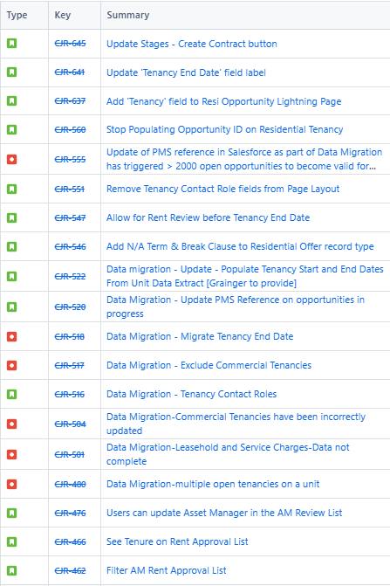
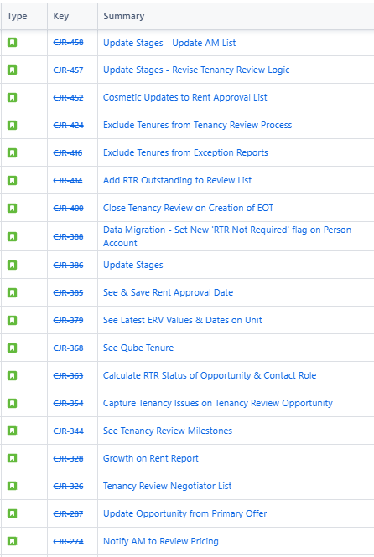
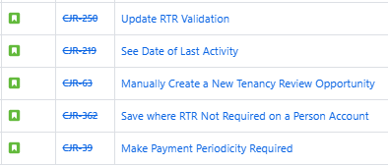
Work Items Delivered

Slide 4
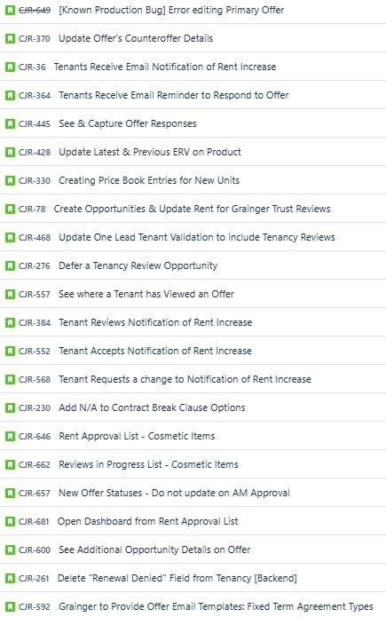
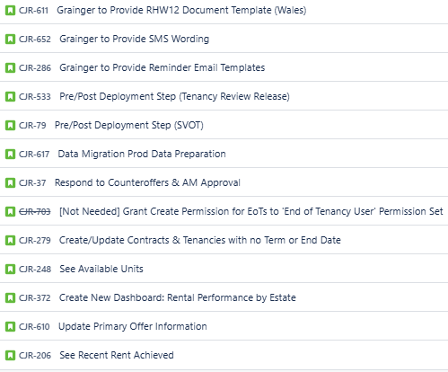
Work Items Planned for Next Sprint

Slide 5
General Items
Items Carried over to next Sprint | Reasons
None
Risk | Contributing factors | Impact | Decisions taken
None
Issue | Contributing factors | Impact | Decisions taken
None
Decision | Description | Date

Slide 6

Thank You

